Slide 1

Sajid Khan

Slide 2
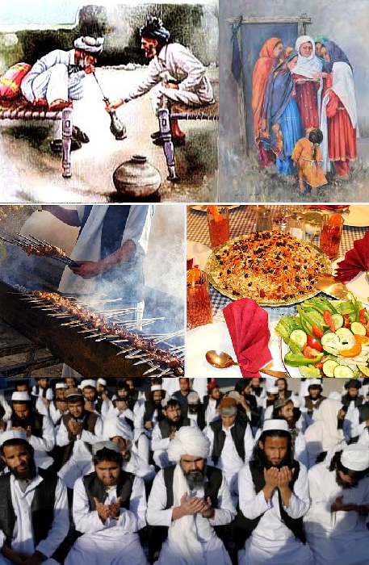
Culture
Culture is often described as a vague, multifaceted concept with fluid boundaries, meaning different things in various contexts. Unlike clear-cut concepts with stable definitions, culture is adaptable, with layers of significance that shift depending on the situation. It encompasses all that is socially shared and learned within a society, including beliefs, art, religion, values, norms, ideas, laws, knowledge, customs, and the capabilities acquired by individuals as members of that society.
.

Slide 3

Elements of culture
Culture is composed of numerous elements. The major elements of culture are symbols, language, norms, values, and artifacts.
Language is an essential element of culture, playing a crucial role in shaping the way individuals and societies think, communicate, and interact with each other. Every culture has its unique language, and it is often deeply ingrained in its customs, traditions, and practices, providing individuals with a shared sense of identity and belonging.
Language can also influence the way in which individuals think and perceive the world around them. For example, some cultures have multiple words for a single concept or idea, while others may have words that are difficult to translate into other languages. These linguistic differences can shape the way in which individuals approach and interpret the world around them.

Slide 4
Elements of culture
Norms refer to the rules or expectations that are accepted and practiced within a culture. They guide and regulate appropriate behavior within a culture, group, or society, ensuring social cohesion and order. Norms can vary based on factors such as age, gender, religion, occupation, or ethnic background, and are considered fundamental building blocks of social structure, making them a key subject of sociological study. There are four main types of norms that help inform individuals about behaviors considered acceptable: folkways, mores, taboos, and laws.
Folkways are informal practices that are learned and shared by members of a social group, often referred to as "customs." These behaviors are not morally significant but are important for social acceptance. For example, in many cultures, shaking hands when greeting someone is a folkway. While not essential for moral conduct, failing to adhere to this custom might result in social awkwardness or a perception of rudeness. Folkways can differ among groups, but some customs may be widely embraced across a larger society.
Mores are norms that are deeply rooted in a society's sense of morality, distinguishing between right and wrong. Violating a more is typically considered offensive and may lead to social condemnation. In some cases, a more violation may also be illegal, but this is not always the case. For instance, in many cultures, infidelity is considered morally wrong (a violation of mores), yet it may not be illegal. Conversely, acts like theft are both morally wrong and illegal, thus sanctioned by law.

Slide 5
Elements of culture
Taboos refer to prohibitions against certain behaviors, activities, or relationships that are considered unacceptable or forbidden by a culture. Unlike laws, taboos are not written down but are passed down through socialization. Taboos serve to maintain social order by restricting behaviors deemed harmful or inappropriate. For example, in English culture, it is taboo to ask someone about their salary, weight, or reasons for not being married. Such questions are seen as intrusive and inappropriate, even though there may be no formal rules against asking them.
Laws are formal rules enacted by the state and enforced by legal institutions. They represent the codification of certain norms, especially those that are essential for the functioning of society. For example, child abuse is both a taboo and a criminal offense, as it violates deeply held moral standards and is prohibited by law. However, not all mores are codified into law; for example, a man walking shirtless in public might be considered offensive in some cultures (a violation of mores), but it is not illegal

Slide 6
Elements of culture
Values are deeply held assumptions that is shared by members of a particular culture, guiding their behaviors, decisions, and judgments. These values represent what a society collectively views as important, desirable, and morally right. They influence how individuals within that culture interact with one another, perceive the world, and make choices in various aspects of life, including family, work, education, and social relationships. For example, in many Western cultures, individualism is a core cultural value, emphasizing personal autonomy and self-reliance. In contrast, in many Asian cultures, collectivism is a key value, where the well-being of the group, such as family or community, takes precedence over individual desires.
Artifacts are objects created by humans that reflect specific cultural moments or practices. These items, when discovered, provide valuable insights into the society that made or used them. Archaeologists have uncovered numerous artifacts from ancient societies, each offering a glimpse into the lives, beliefs, and practices of the people who created them.
Cultural artifacts are significant because they contain vital information about the people and the culture to which they relate or in which they were used. These artifacts can be economic, political, religious, or social in nature, as long as they are representative of the society from which they originated. For example, an ancient coin might reveal information about a civilization's economy and trade, while a religious idol might provide insights into their spiritual beliefs and rituals.

Slide 7
Characteristics of Culture
Some of the important characteristics of culture are:
Culture is Learned: Culture represents the behaviors and ways of life of a particular group. It is not innate but acquired through interactions with family, friends, teachers, and social media. Individuals learn cultural practices, such as dressing, behaving, and eating, from their environment.
Culture is Shared: Culture exists within a society and cannot be possessed by an individual alone. Members of a society share common values, ideas, and perceptions, which shape their collective cultural identity. This shared culture helps individuals act in socially appropriate ways and understand each other's actions. However, multiple cultural subgroups coexist within any society.
Culture is Transmitted: Culture is passed from one generation to the next through language, imitation, and instruction. Unlike genetic traits, cultural traits are learned and transmitted socially.
Culture is Dynamic: While culture is relatively stable, it evolves over time through interactions and exchanges with other cultures. Changes in one aspect of culture often lead to adjustments across the entire cultural system, allowing it to adapt to new contexts.

Slide 8
Characteristics of Culture
Culture is Accumulative: Culture develops gradually, incorporating beliefs, art, morals, and knowledge accumulated over time. It builds upon past achievements and continues to evolve, forming a "growing whole" that influences future advancements.
Culture is Based on Symbols: Symbols—such as words, objects, gestures, or images—are crucial to culture. They represent meanings beyond themselves and are used to communicate. For instance, a red octagonal sign means "stop," while symbols like the Confederate flag can have varied interpretations, such as pride or racial oppression.
Culture can be Ethnocentric: Ethnocentrism is the belief that one's own cultural practices and background are superior to others. It involves viewing the world from one's own cultural perspective and considering other cultures as inferior or incorrect. Ethnocentrists often see their cultural norms as the standard and view different behaviors as strange or wrong.

Slide 9
Popular culture
Popular (Pop) culture refers to the set of ideas, practices, images, and phenomena that are prevalent and widely accepted within a society at a given point in time. It encompasses various aspects of daily life, including entertainment, fashion, music, sports, and technology, reflecting the shared interests and preferences of the general public. Popular culture is dynamic and evolves over time, influenced by social, political, and technological developments, making it a key area of study within the realm of social science.
Early popular culture emerged from oral traditions and rituals that shaped communal identities, transmitting values across generations. Industrial revolution and urbanization blended diverse cultural practices. The 20th century saw radio and television expand the reach of popular culture, introducing new cultural forms and global influence.
Film, television, music, dance, and literature are central to popular culture, shaping societal conversations and cultural movements. Fashion reflects and influences societal values, acting as a form of cultural symbolism. Sports mirror societal values and foster global unity, with major events like the FIFA World Cup reflecting social dynamics.

Slide 10
Elite Culture
Elite culture refers to the "high" cultural practices and institutions associated with the educated, affluent ruling classes. It is characterized by a restricted and exclusive structure, often found in universities, academies, libraries, and Masonic lodges—venues that symbolize aristocratic status. While elite culture has influenced and sometimes been overshadowed by popular culture, its significance persists. However, the exclusive hold of social elites on elite culture has diminished as they have developed more diverse tastes, embracing cultural works across a broad spectrum, from lowbrow to highbrow.
In Pakistan, the elite monopolizes state and society, controlling social, cultural, economic, and political orders at the public's expense. They manipulate narratives to maintain dominance, while the middle class, typically a force of resistance globally, is instead absorbed into the elite structure. The village middle class, influenced by class hierarchies and colonial legacies, is more focused on gaining status than challenging the status quo. This desire to join the elite is evident in the obsession with civil service, judiciary, and military careers, seen as gateways to elite membership. To challenge this monopoly, the middle class must unite politically and mobilize the marginalized to create governments that reflect the people's true choice.

Slide 11
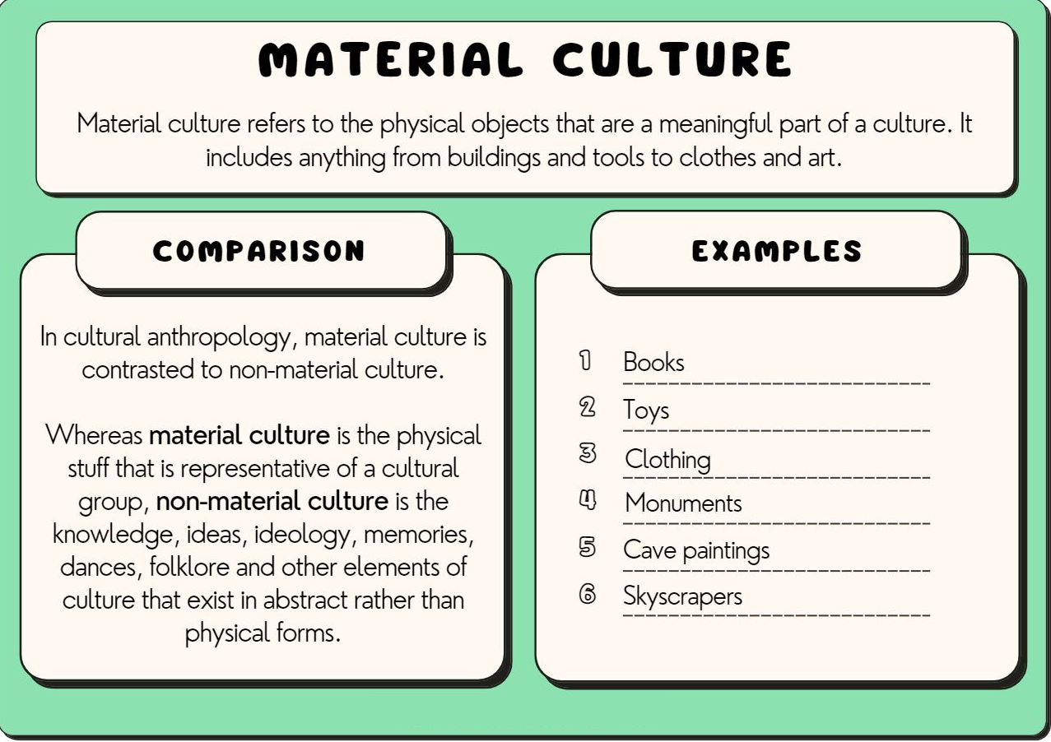

Slide 12
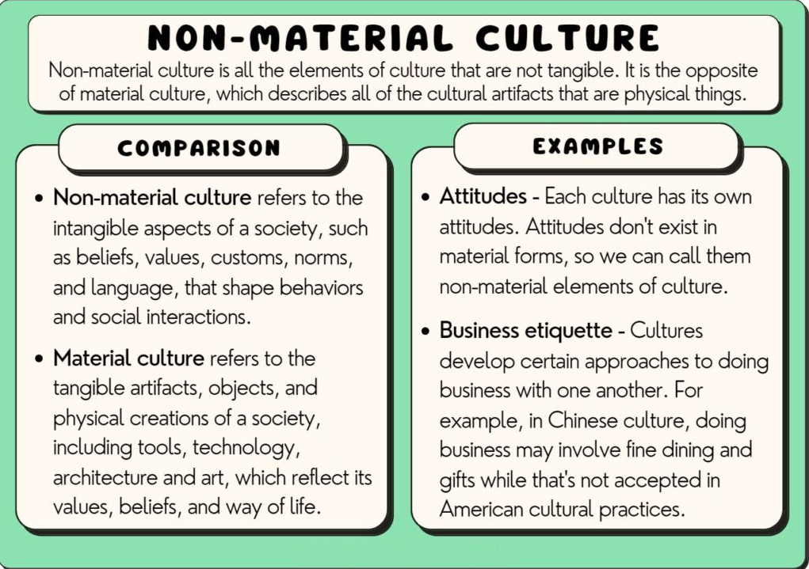

Slide 13
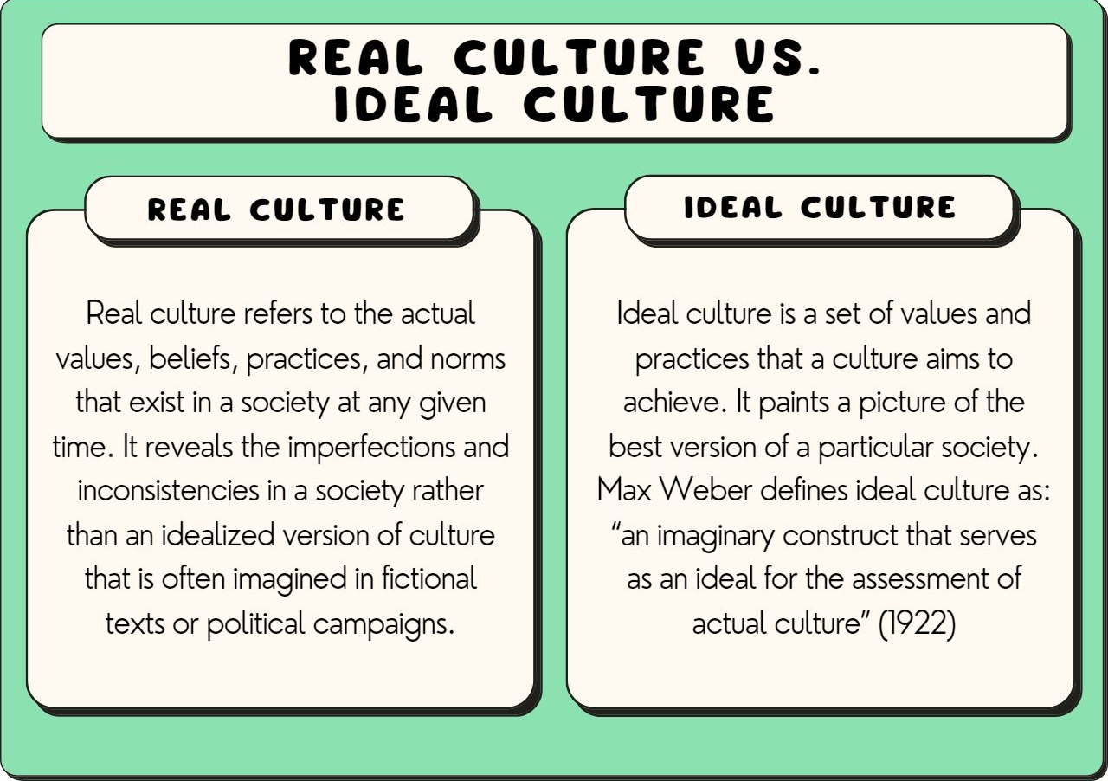

Slide 14
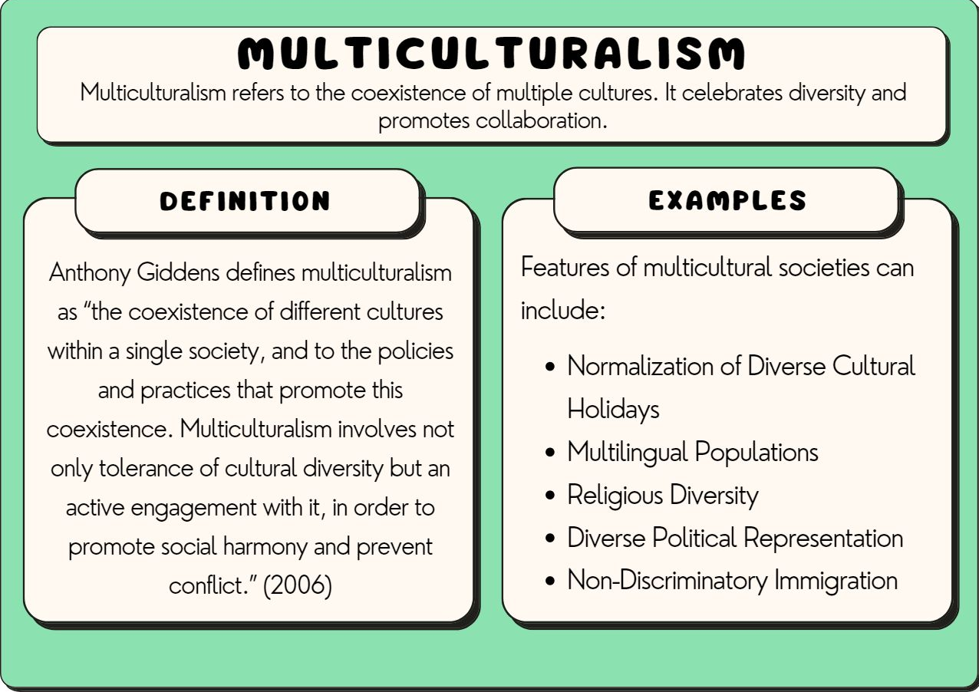

Slide 15
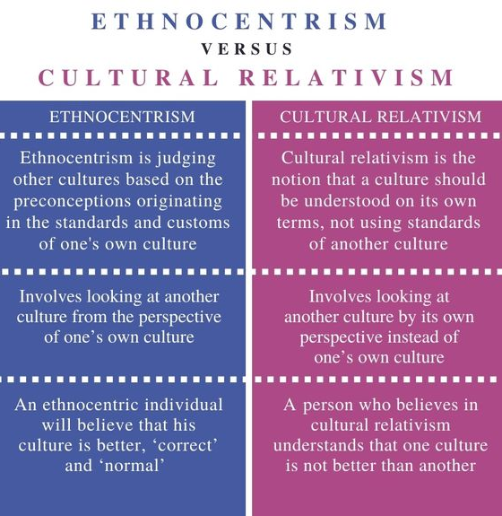

Slide 16
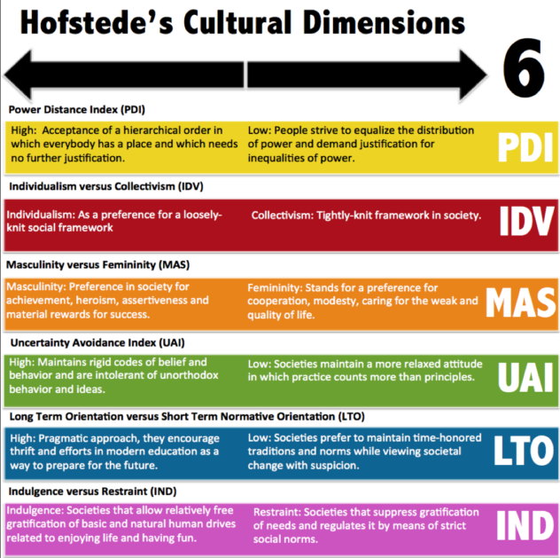

Slide 17
Individualism VS. Collectivism
Culture parameters | Individualistic organizational culture | Collectivist organization culture
Interference with employees' privacy | Management does not want to interfere with the employees privacy | Employees expect the organization to participate in their personal affairs
The organization impact on the wellbeing of employees | Weak | Strong
Interests protection | Employees believe that they should rely only on themselves, defend their interests | Employees expect the business to protect their interests
Enterprise operation | Individual initiative of each member of the organization | A duty and employee loyalty sense
Career advancement | Within or outside the organization based on competence | Exclusively within the organization in accordance with the experience
Motivation | Leadership uses new ideas and methods, stimulates the activity of individuals and groups | Leadership uses traditional forms

Slide 18
Authoritarianism VS. Power sharing
Culture parameters | High power distance culture | Low power distance culture
Subordinates frequency expressing their disagreement | Low | High
Management style preference | Directive | Democratic
Inequality perceptions | People inequality | Roles inequality
Attitude towards managers | Subordinates see their leaders as "other" people | Subordinates view their senior management as human beings
Guide availability | Top management not available | Top executives available
Relationship to law | Orders are not negotiable | Law takes precedence
Organization structure | Multilevel, tendency towards centralization | Flat, tendency towards decentralization
Management staff size | A large number of managing and controlling employees | The management team is smal
Wages differentiation | Big | Small enough
Lower level workers' qualifications | Low | High
Workers and employees status | “White collars” have a higher status | Workers have the same status

Slide 19
Uncertainty avoidance index
Culture parameters | Low uncertainty avoidance culture | High uncertainty avoidance culture
Time attitude | Staff willingness to live in the day | Staff have great anxiety about the future
Preferred organization size | Workers prefer a small organization | Workers prefer large organizations
Middle managers age | The youth | Middle and elderly
Motivation to achieve the goal | Sustainable | Low
Attitude towards success Hope for success Fear of failure | Hope for success | Fear of failure
Willingness to take risks | Big | Weak
Preferred career type | Preference for a managerial career over a career as a specialist | Preference for a specialist career over a managerial career
Manager qualifications | The manager is not a management specialist | The manager must be an expert, a specialist in the management field
Attitude towards conflicts | Conflict in an organization is seen as a natural state | Organization conflicts are undesirable
Competition between workers | Normal and productive phenomenon | Rivalry is discouraged
Preparedness for uncertainty at work | High | Low

Slide 20
Masculinity vs. Femininity
Culture parameters | "Male" culture | "Female" culture
The man and woman role | A man must earn money, a woman must raise children. | . A man does not have to make a living; he can be engaged in raising children.
Domination | A man should dominate in any situation. | The difference between the sexes does not affect the occupation of positions of power.
The main value | Success is the only thing that matters in life | Life quality
Life and work | Live for work | Work to live
What is important. | Money and good material conditions | Men and environment
Aspiration | Always be the best | Equality orientation, not trying to be better than others
Attitude towards freedom | Independence | Solidarity
Feeling | Respect those who have achieved success | Empathy for the losers
Making decisions | Logic | Intuition

Slide 21
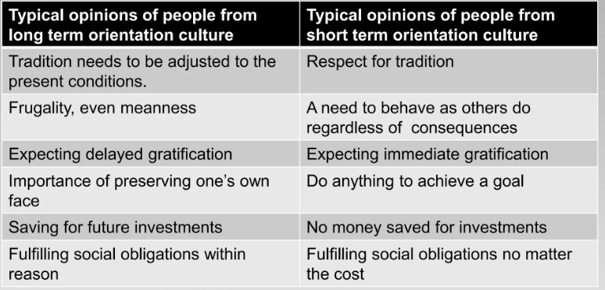
Long Term Vs. Short Term Orientation

Slide 22
Restraint vs. indulgence
The last dimension among Hofstede’s cultural dimensions is that of indulgence. Basically, the dimension aims to determine how indulged and engrossed people are in their personal life, happiness and feelings.
Restraint | Indulgence
Gratification suppressed and regulated | Freely satisfy basic needs and behaviour
Expects (material) reward for job done well | Cannot easily be motivated with material reward
Easily feels treated unfair | Enjoys moment rather than uses time to compare with others
Status objects important, e.g. phone, laptop, watch, car | Objects need to fulfil purpose not status

